Slide 1
Smart System for Bikers
Project Guide : Mrs.A.H.Tirmare
Seminar Presented by:
Shreeraj Doddannawar
Shreepad Sadhale
Gunesh Kulkarni

Slide 2
Introduction:
Need
Increasing number of road accidents.
No fast service available on accidental spot.
Traffic rules are not followed.
No control on vehicle speed.
No anti-theft system for bike.
Proposed system
Makes mandatory for bikers to wear Helmet.
It prevents death in accidents.
SMS Alert to family members/nearby hospitals/control room.
GPS Co-ordinates of accident is also sent.
Helps to implement Government Law.
Additional theft protection can be provided.

Slide 3
System requirements:
GPS module.
GSM module.
RF transmitter and receiver module.
Encoder and decoder module.
Speed sensor.
Collision sensors.
Relay driver IC.
LCD display.
Microcontroller.

Slide 4
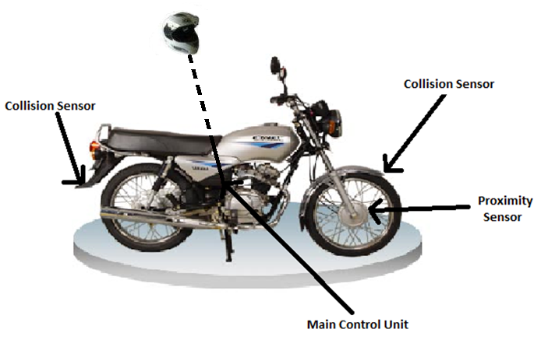
Implementation of System

Slide 5
Block Diagram

Slide 6
Helmet System
Key Matrix
Encoder
RF Transmitter

Slide 7
LCD
Microcontroller
Max 232
GPS
Fuel Valve
Relay Driver
Collision Sensor
GSM
Battery
Speed Sensor
Decoder
RF Receiver

Slide 8
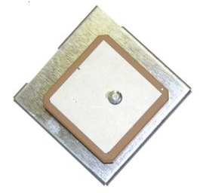
GPS Module features: (GPS-320FW)
16 parallel channel GPS receiver
4100 simultaneous time-frequency search bins
High Sensitivity
Fast Acquisition
Accuracy:
Position 5m CEP
Velocity 0.1m/sec
Serial Interface RS-232
Input Voltage 3.8V ~ 8.0V

Slide 9
GPS – How it works
All satellites have clocks set to exactly the same time.
All satellites know their exact position in space from data sent to them from the systems controllers.
Each satellite transmits its position and a time signal.
The signals travel to the receiver delayed only by distance travelled.
The receiver calculates the distance to each satellite and
trilaterates its own position.

Slide 10
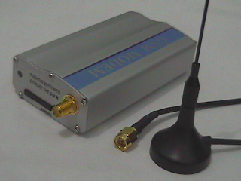
GSM Module Features:
SIM card holder supporting 1.8 V and 3 V card type.
MMCX Interface connector for RF output (50 Ohm connector MMCX
Edge Mount SMD J01341A0081.
60 pin board-to-board connector (CVILUX CBRB060PC2000R0): Audio (2x analog, 1x digital), I2C bus, SPI bus, 2x ADC, 2x analog out (PWM),12 GPIOs.
1 UART serial port.

Slide 11
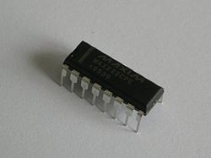
Max 232 Features:
Converts signal from serial port to TTL logic.
Typically converts RX,TX,CTS&RTS signal.
Operated at higher baud rates.
Provides O/P voltage level approx.7v
Receiver gets I/P standard 5v.

Slide 12
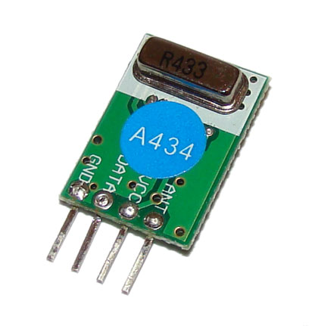
RF Transmitter Features:
No external components and no tuning required.
High Performance SAW Based Architecture with a maximum Range of 100 feet at 9600 bps data rate.
Interface directly to Encoders and Microcontrollers with ease.
Low Power Consumption
suitable for battery operated devices.
4 Pin Compact size module
Can be directly used in your PCB

Slide 13
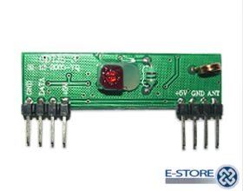
RF Receiver Features:
Frequency: 433.92MHz Crystal Locked
Modulation: 99% ASK
Sensitivity: -115dBm
Temperature Range: Operation: -10C ~ +60C ,
Storage: -20º C ~ +70º C
Power Source: 5V DC
Current Consumption: 16mA @ 5V
Data Rate: 9600bps Max
RF Frequency Tolerance: +/- 30 ppm

Slide 14
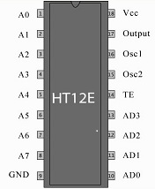
RF Encoder(HT 12E)
Features :
Operating voltage- 2.4V~12V for the HT12E
Low power and high noise immunity CMOS technology
Low standby current: 0.1_A (typ.) at VDD=5V
Minimum transmission word

Slide 15
RF Decoder
Features :
Operating voltage: 2.4V~12V .
Low power and high noise immunity CMOS technology.
Low standby current.
Binary address setting.
Received codes are checked 3 times.
Address/Data number combination.
HT12D: 8 address bits and 4 data bits.
Minimal external components .

Slide 16
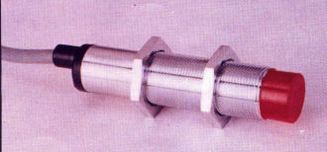
Specifications of Proximity Sensor:
Supply Voltage (nominal) :10-60V DC
Voltage Drop across the Switch : Less than 6.8V
Maximum Load Current (Continuous) : 100 mA
OFF State Current :less than 1 mA
Operating Temperature : -25°C to +70°C
Hysterisis : 15% max.
Switching Frequency : 5 Hz typical
Output Logic : NO or NC
Environmental Protection : IP 67
Status Indication : Through LED

Slide 17
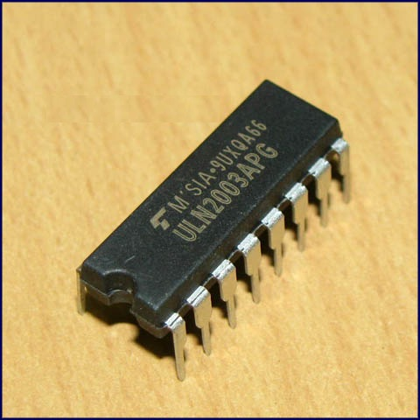
ULN2003 Relay Features:
Seven darlingtons per package
Output current 500ma per driver. (600ma peak).
Output voltage 50v
Integrated suppression diodes for inductive loads.
Outputs can be paralleled for higher current
TTL/CMOS/PMOS/DTL compatible inputs.
Inputs pinned opposite outputs to simplify layout.

Slide 18
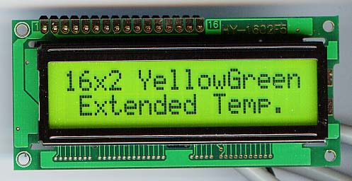
LCD Display:
General Features:
Display size: 16 character * 2 lines.
Character structure: 5*8 dots.
Display data RAM: 80 characters (80*8 bits)
Character generate ROM: 192 characters
Character generate RAM: 8 characters (64*8 bits)
Both display data and character generator RAMs can be read from MPU.
Internal automatic reset circuit at power ON.
Built in oscillator circuit.

Slide 19
Microcontroller requirements:
Four ports required.
Three timers.
Speed calibration and calculation.
Delay in program.
Baud rate generation for Serial Communication.
Due to complexity in programming extra memory is required

Slide 20
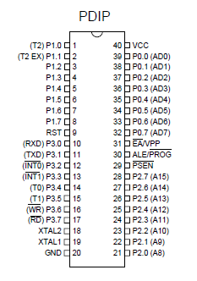
Microcontroller Features:(89C52)
• 8K Bytes of In-System Reprogrammable Flash Memory
• Endurance: 1,000 Write/Erase Cycles
• Fully Static Operation: 0 Hz to 24 MHz
• Three-level Program Memory Lock
• 256 x 8-Bit Internal RAM
• 32 Programmable I/O Lines
• Three 16-bit Timer/Counters
• Eight Interrupt Sources.
• Programmable Serial Channel.
• Low Power Idle and Power Down Modes.

Slide 21
Advantages:
It prevents death in accident.
The system can’t break easily.
Parameters can’t be change without authentication.
We can keep records and analyze it.
It helps to implement government law.
System can be updated as it is based on software.
System can be integrated in small size.

Slide 22
Applications:
It provides remote control on speed
It provides help at accidental spot.
System gives exact location of bike.
It also provides antitheft facility.

Slide 23
Future scope:
We can reduce the size of the kit by using GPS+GSM on the same module.
We can increase the accuracy of the system by using GPS receivers.
We can use our kit to assist the traffic.
If anybody steals our vehicle we can easily find it around the globe.

Slide 24
References:
www.electronicsforu.com
www.beyondlogic.org
www.discovercircuits.com
www.elecktor.com
http://tripp.iitd.ernet.in/publications/paper/safety/aitd02.PDF
morth.nic.in/.../8Importance%20of%20helmet-final-2418484638.ppt

Slide 25
Thank you

